Slide 1

WEEK 6 PROGRESS REPORT
AIRFRAME TEAM

Slide 2
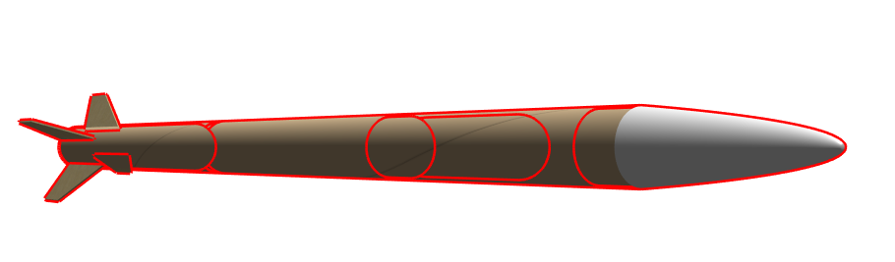
Objectives
Tasks completed
#96Fabrication of the lower body tube for static test
#97Fabrication of upper body tube for the pop test
#98Prepation of test samples for tensile strength test
#99Fabrication of the coupler for joining lower and the upper body

Slide 3
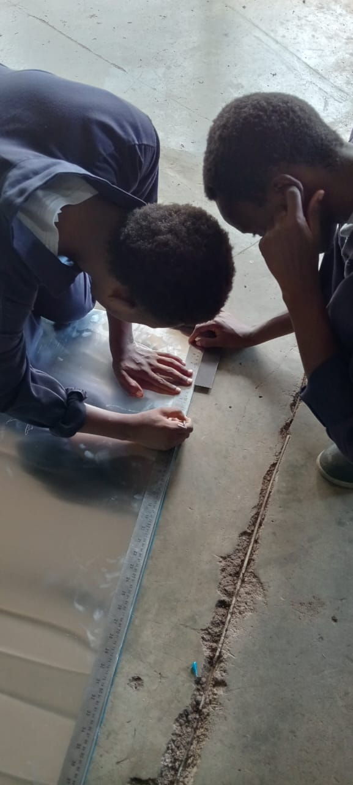
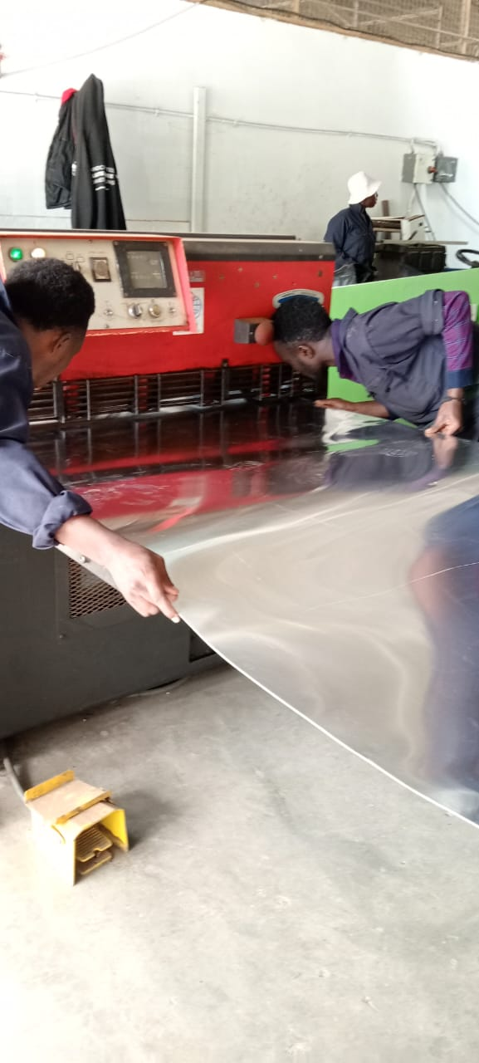
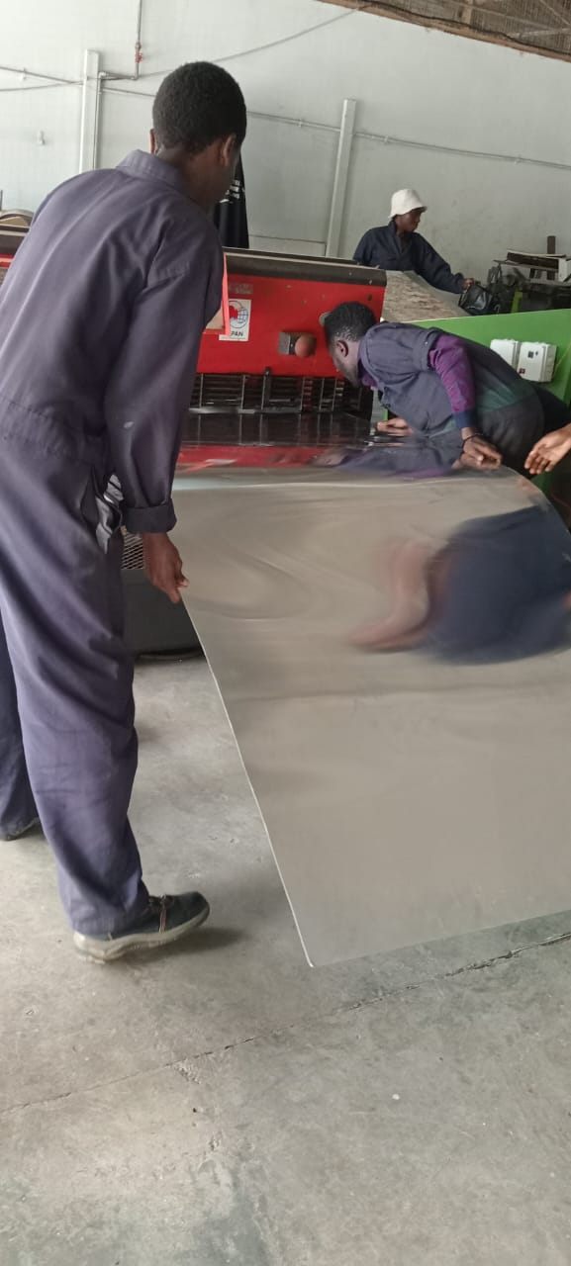
Fabrication of the lower body

Slide 4
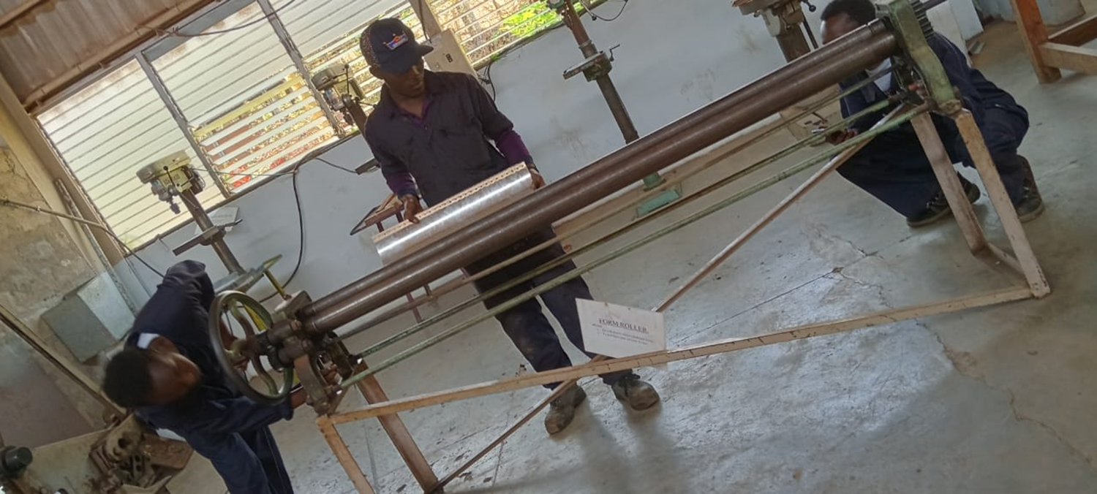
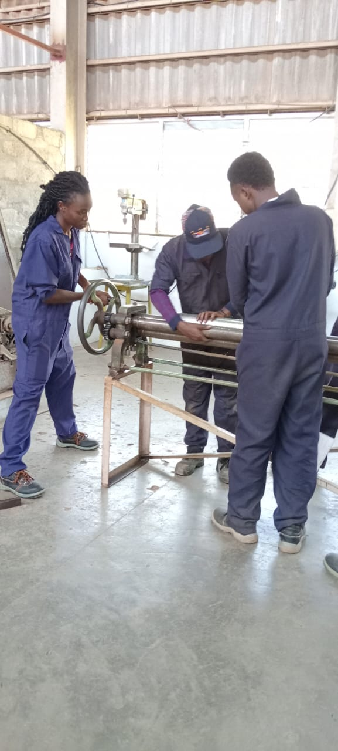
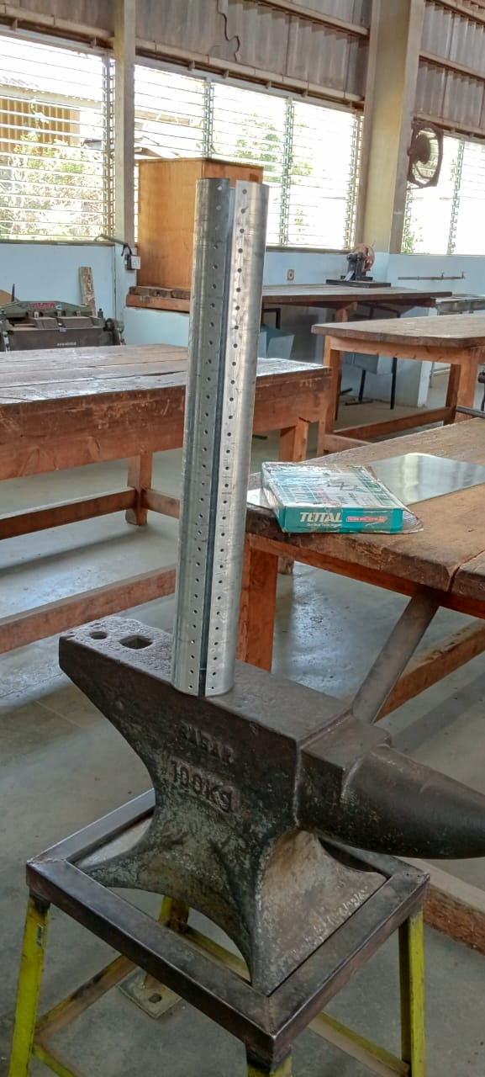
Rolling

Slide 5
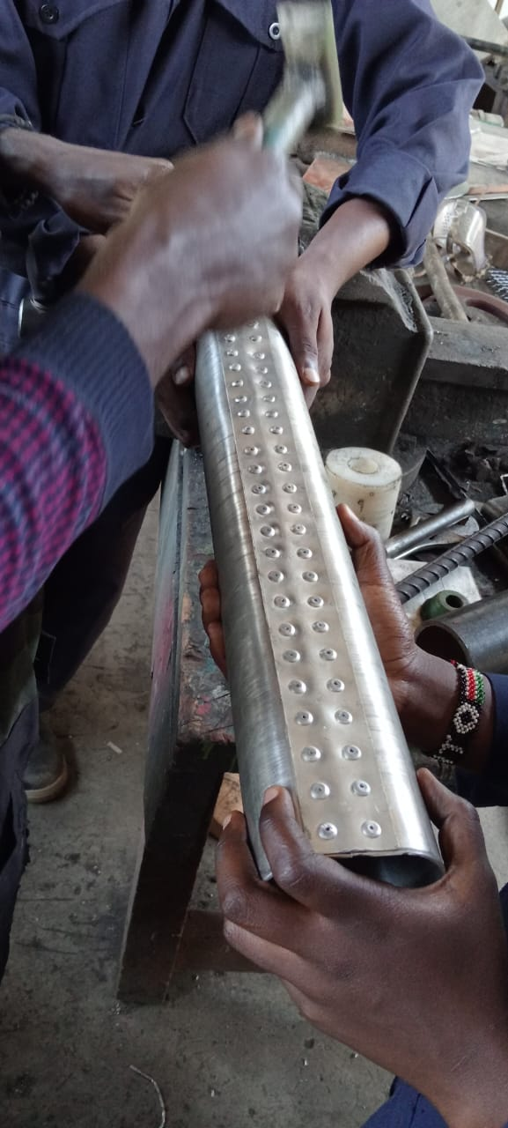
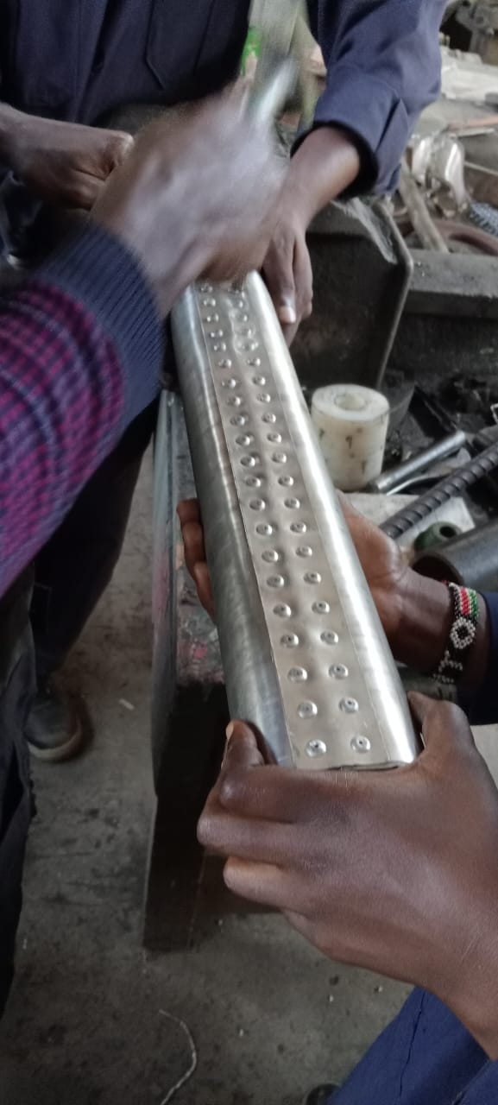
Riveting

Slide 6
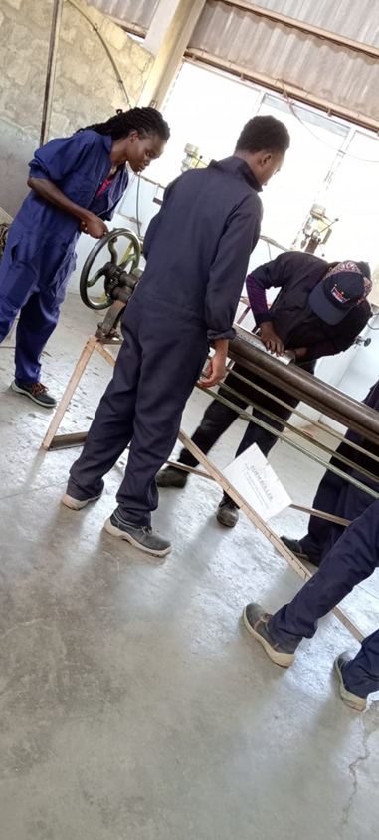
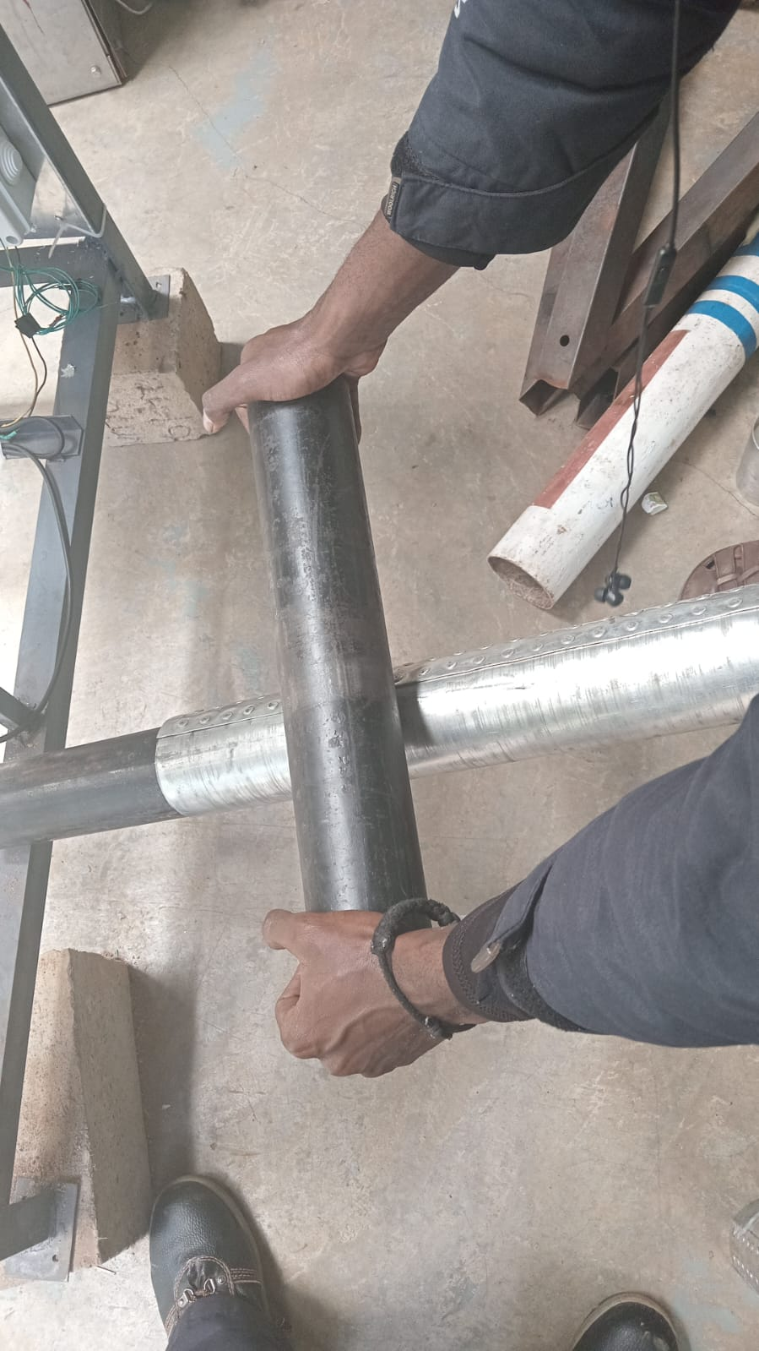
Circularity of the tubes

Slide 7
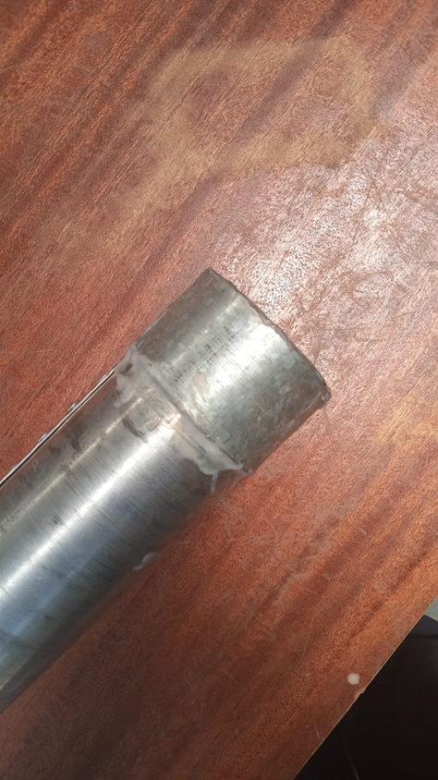
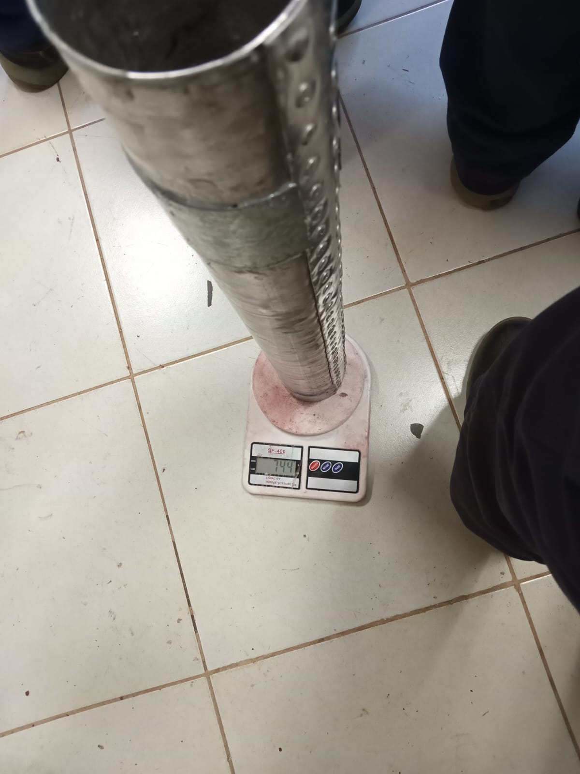
Adding reinforcement on the lower body for static testing

Slide 8
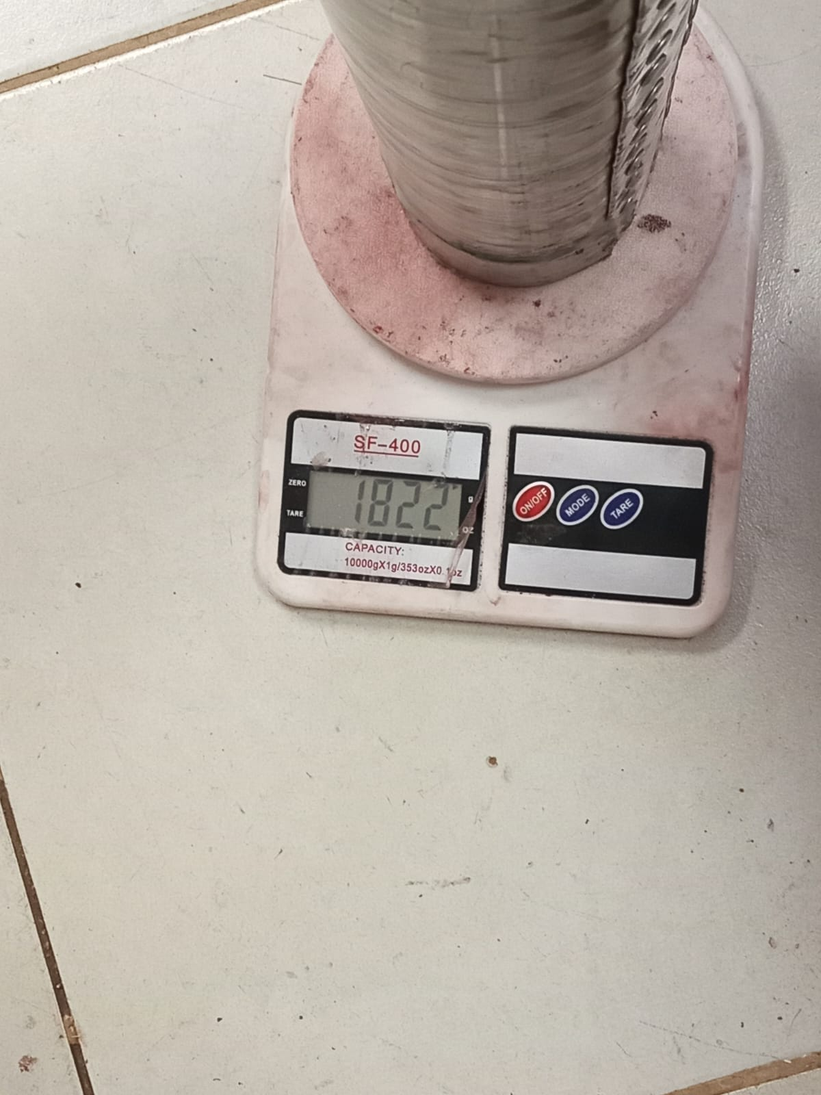
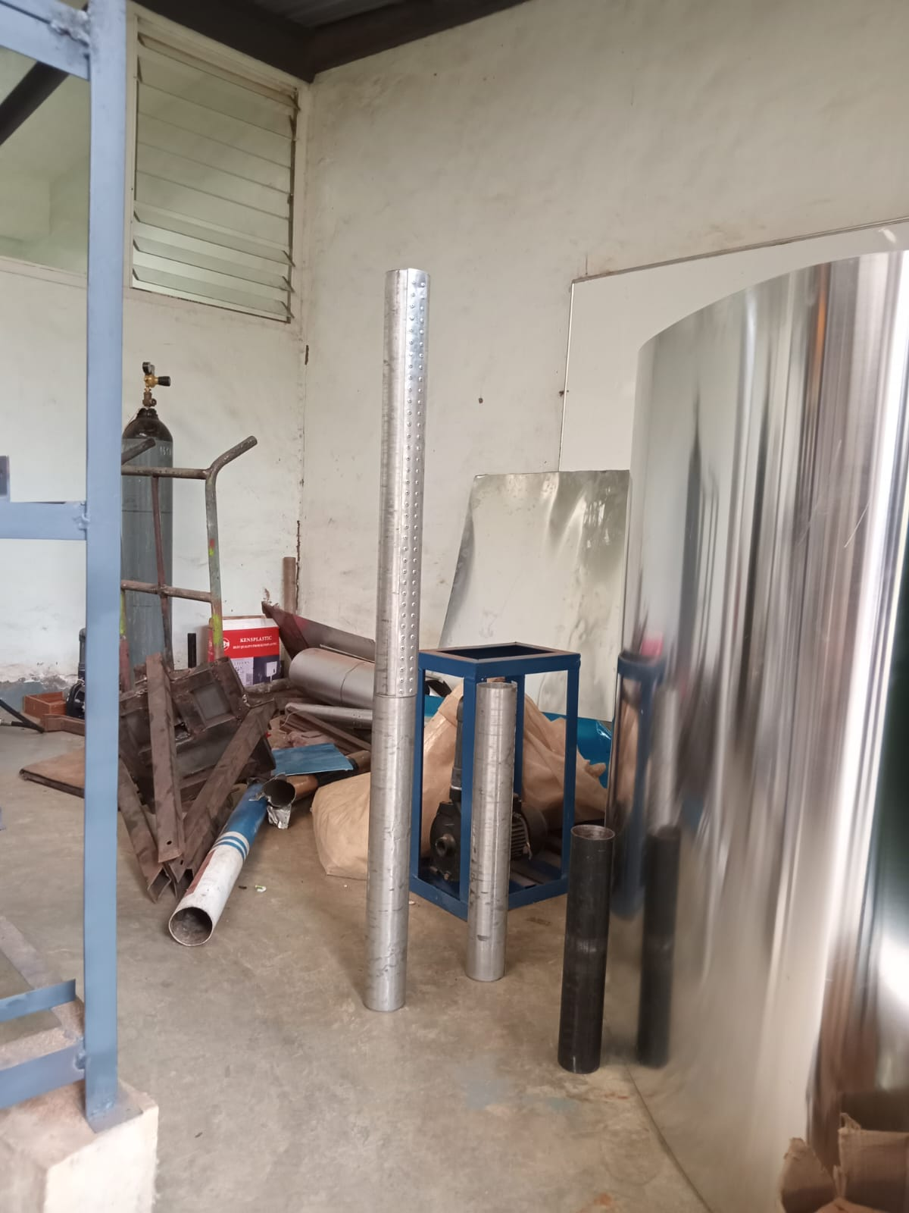
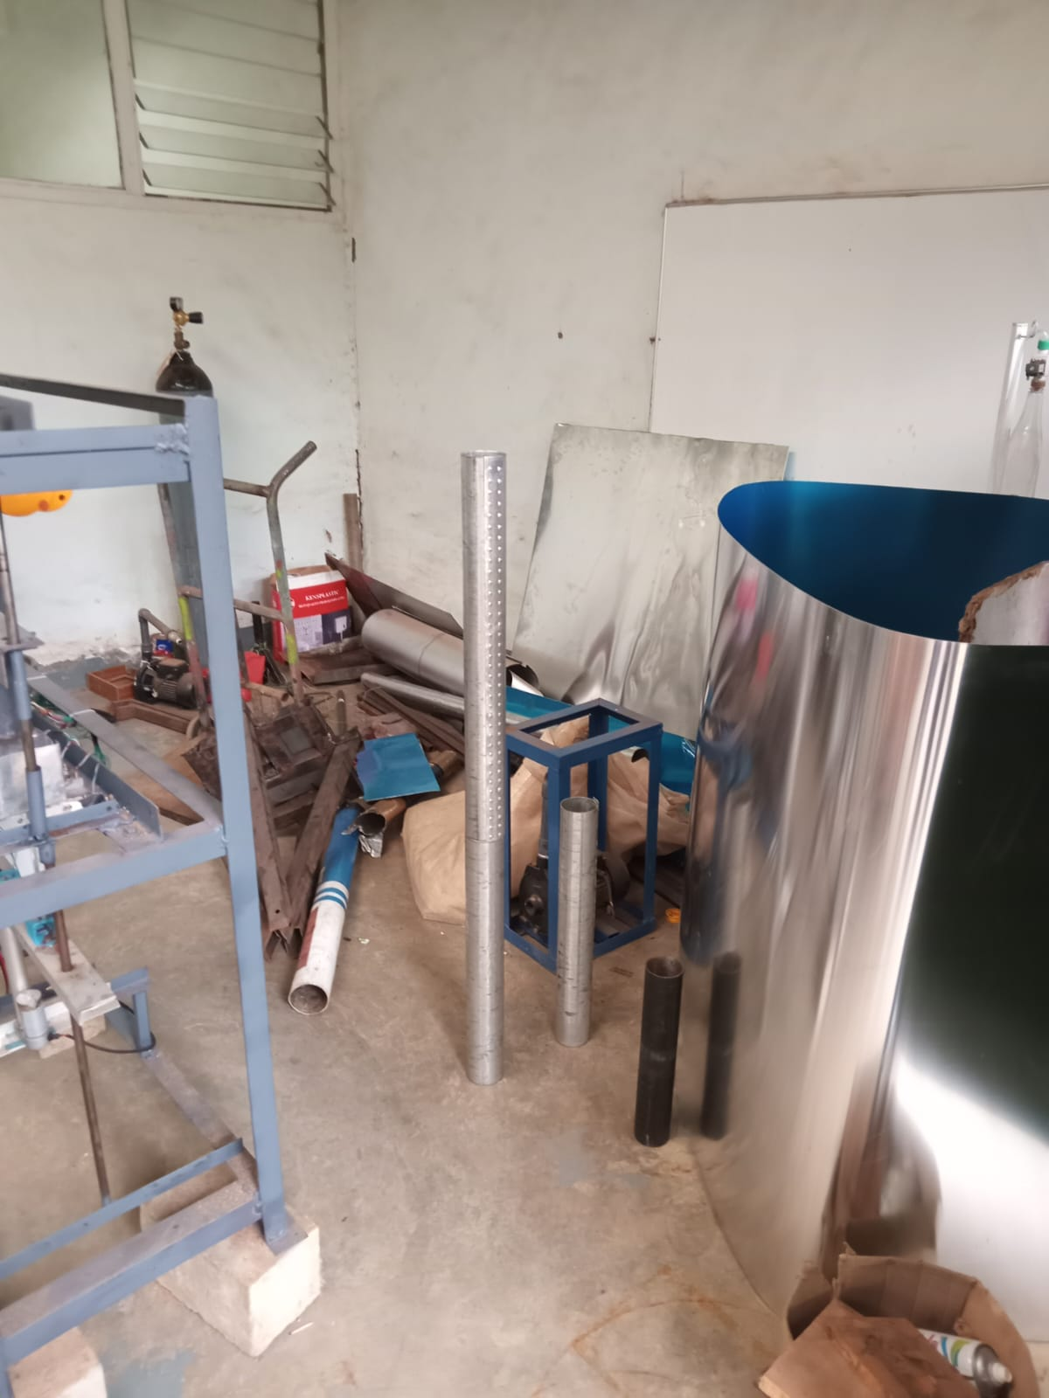
The airframe

Slide 9
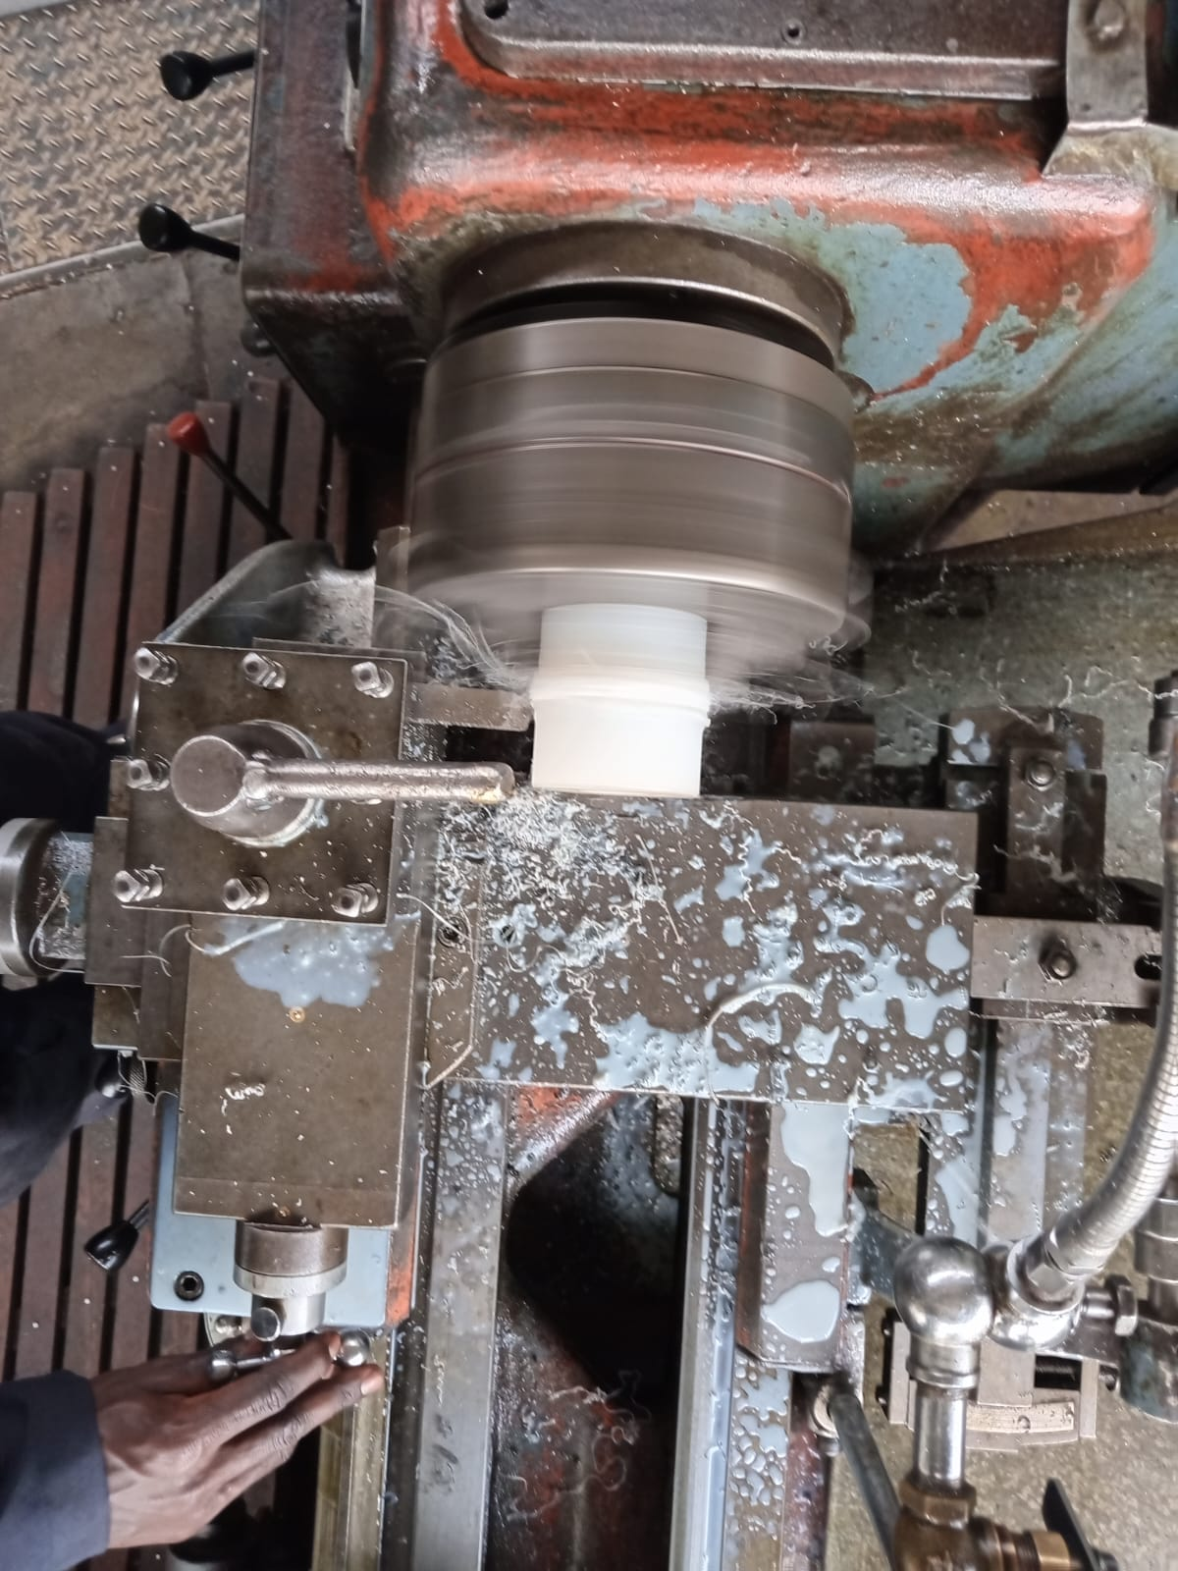
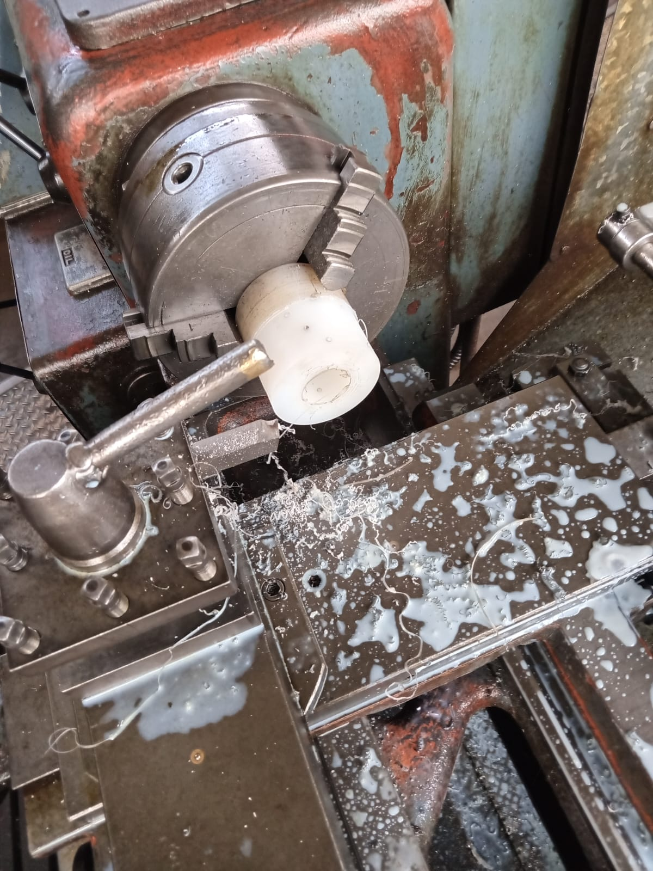
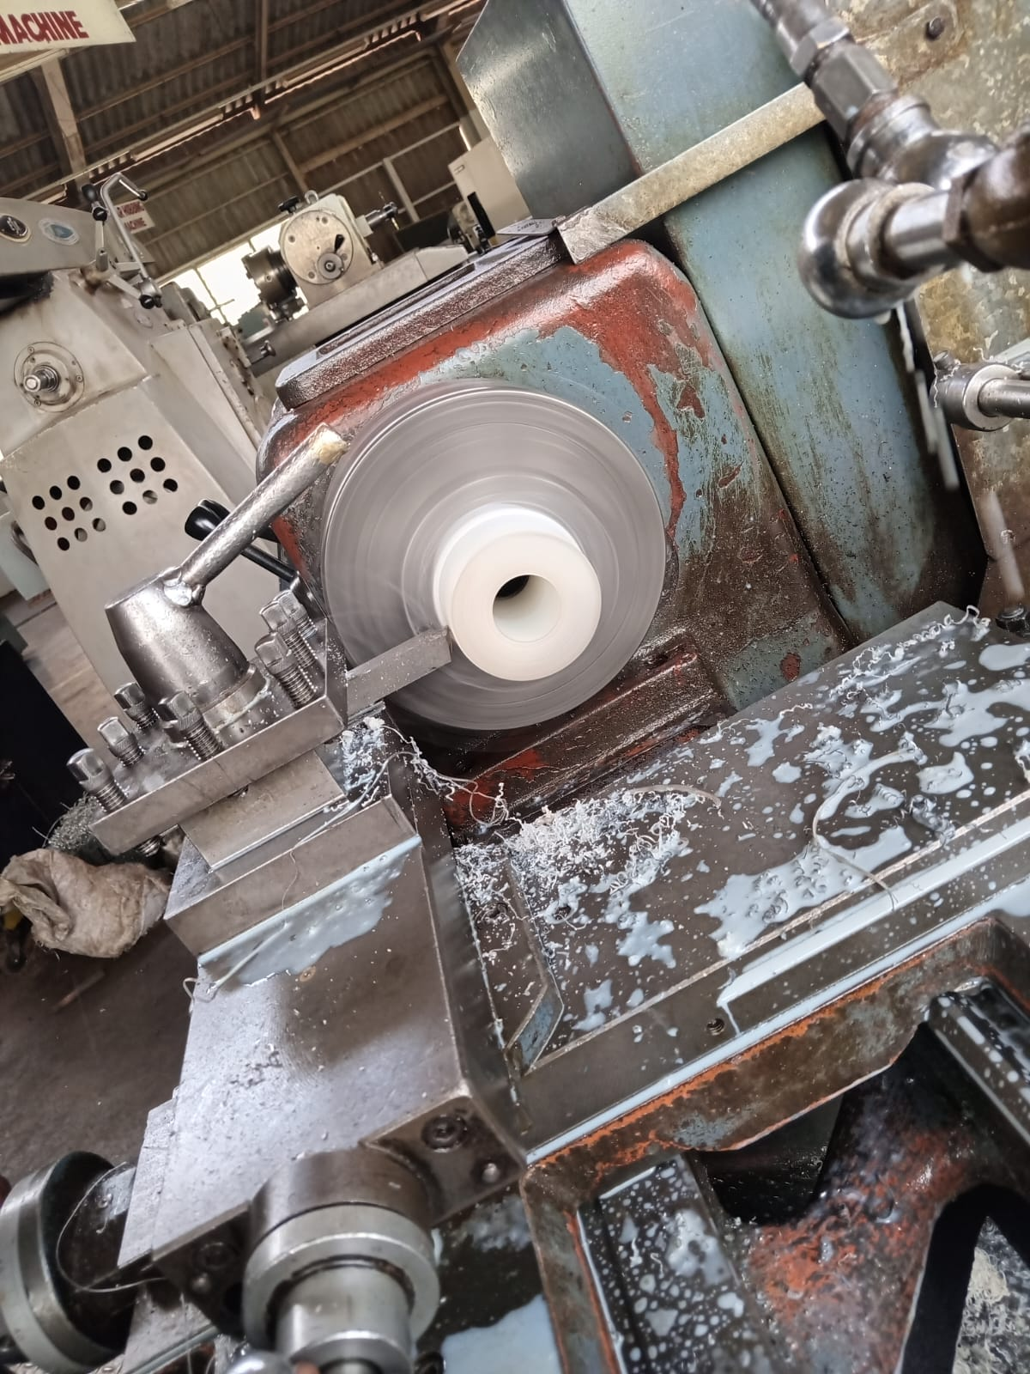
Fabricating the coupler

Slide 10
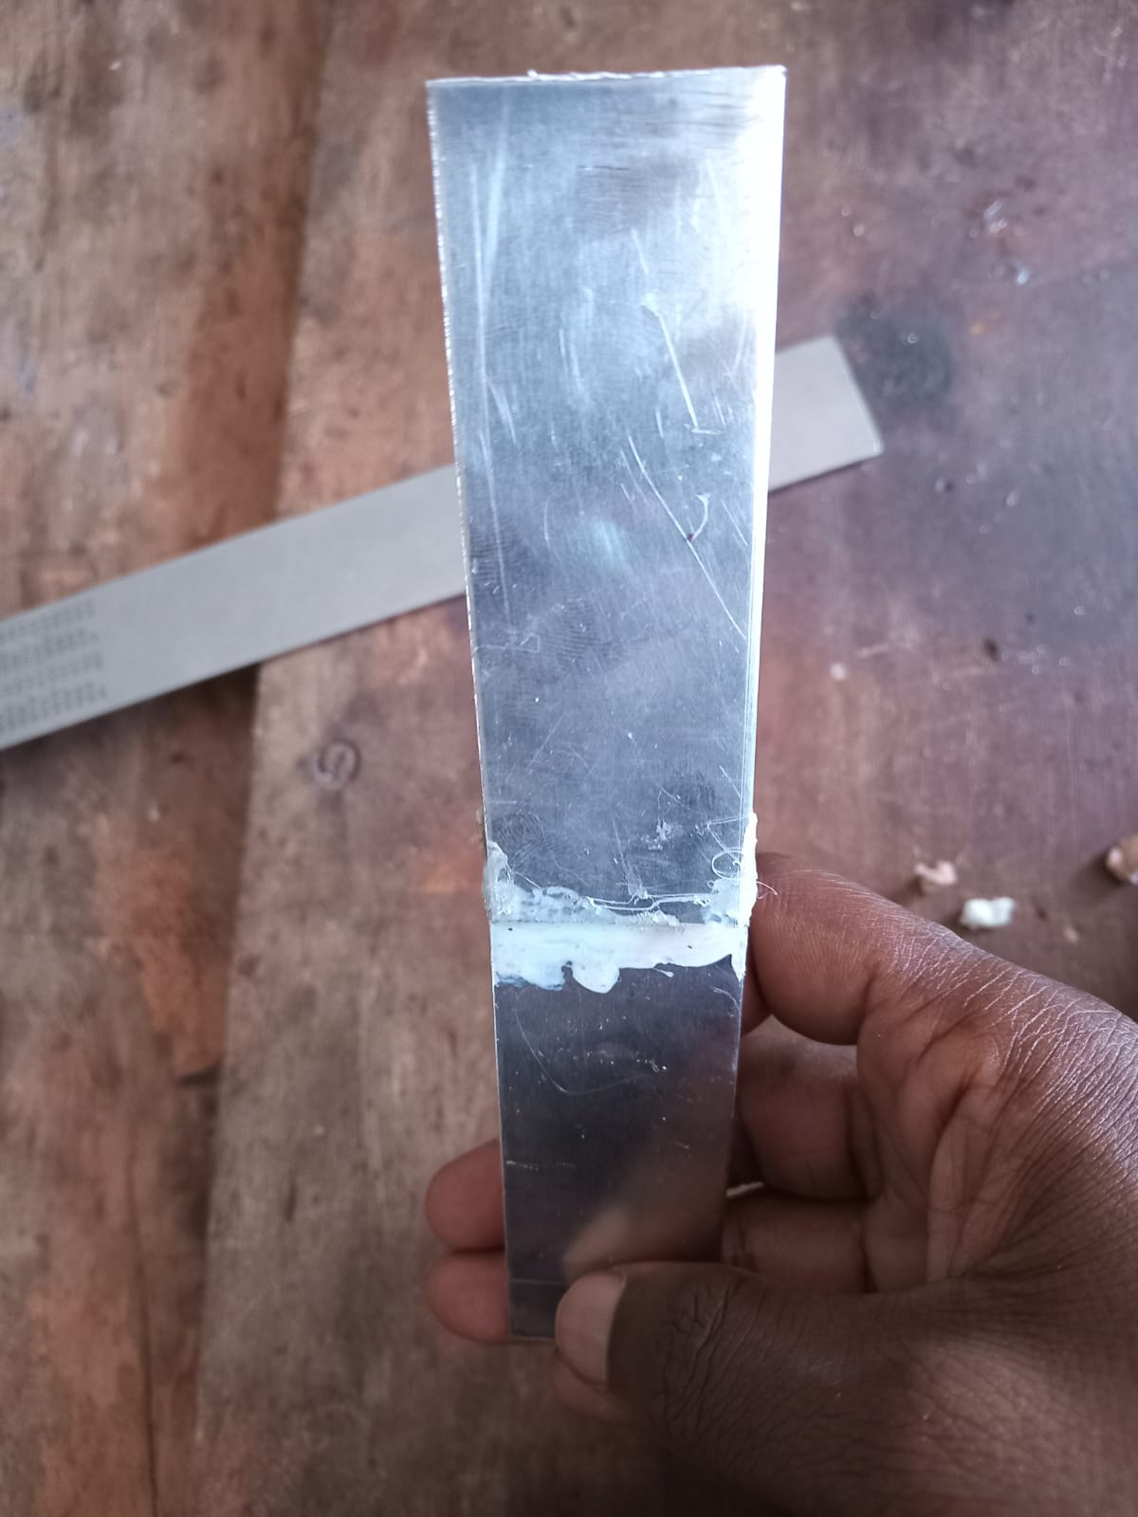
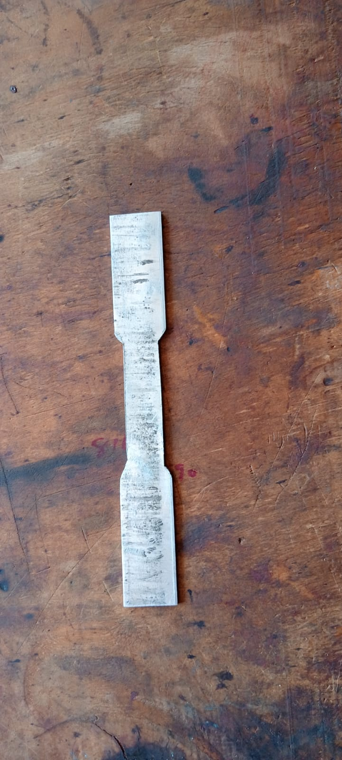
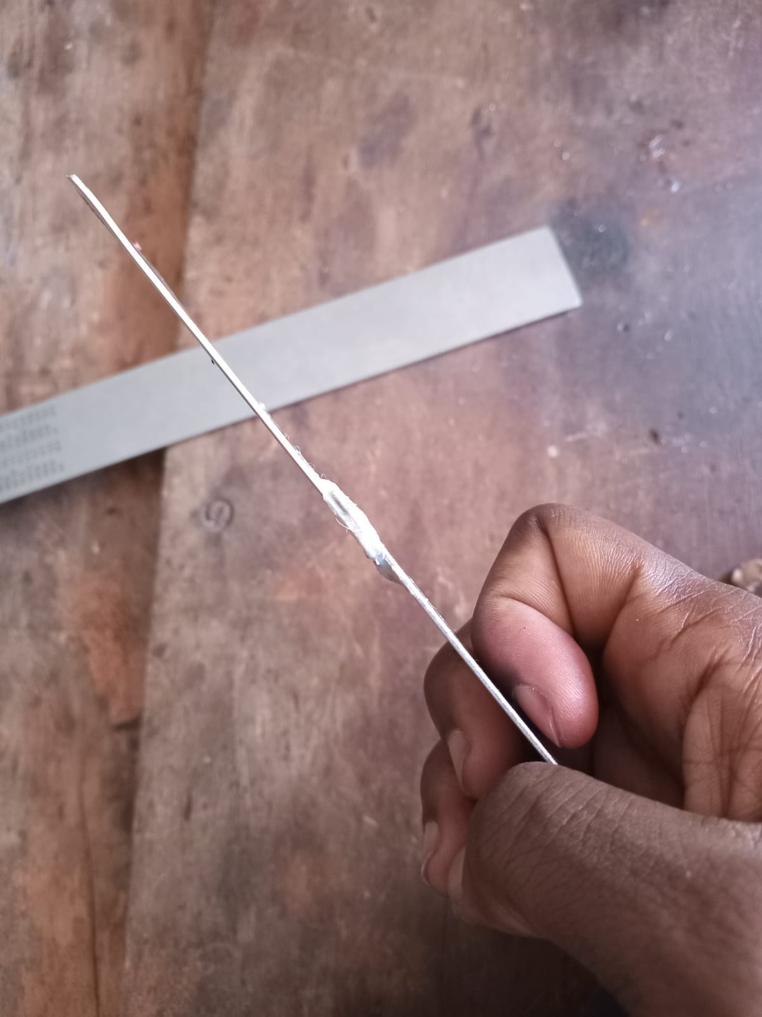
Test samples

Slide 11
Remaining tasks
Testing the strength of epoxy joint
3d printing of the nose cone
Fabrication of the parachute
Fabrication of fins
Acquisition of the remaining material

Slide 12
THANK
YOU

